Slide 1
JavaScript
By
Dr. Ejaz Ahmed

Slide 2
Scripting Language Javascript
JavaScript was designed to add interactivity to HTML pages
JavaScript is a scripting language
A scripting language is a lightweight programming language
JavaScript is usually embedded directly into HTML pages
JavaScript is an interpreted language (means that scripts execute without preliminary compilation)
Everyone can use JavaScript without purchasing a license

Slide 3
Are Java and JavaScript the same?
NO!
Java and JavaScript are two completely different languages in both concept and design!
Java (developed by Sun Microsystems) is a powerful and much more complex programming language - in the same category as C and C++.
JavaScript was invented by Brendan Eich at Netscape (with Navigator 2.0), and has appeared in all browsers since 1996.

Slide 4
Introduction
JavaScript was designed to add interactivity to HTML pages.
JavaScript is a scripting language.
JavaScript is usually embedded directly into HTML pages.
JavaScript is an interpreted language (means that scripts execute without preliminary compilation).
It is an event-driven language.
To insert a JavaScript into an HTML page, use the <script> tag.
Inside the <script> tag use the type attribute to define the scripting language.
The <script> and </script> tells where the JavaScript starts and ends. <script type="text/javascript">

Slide 5
How to use javascript?
The common way to use the javascript is as follows:
Define some HTML tag with ID attribute value given.
In that HTML tag add/call the function statement and bind it to some event on which you want to invoke the javascript function (event handler).
Write the said function (event handler) between <script> and </script> tags.
When the page downloads, your handler will be called on event you described within the HTML tag.

Slide 6
What can a JavaScript do?
JavaScript gives HTML designers a programming tool - HTML authors are normally not programmers, but JavaScript is a scripting language with a very simple syntax! Almost anyone can put small "snippets" of code into their HTML pages
JavaScript can put dynamic text into an HTML page - A JavaScript statement like this:
document.write("<h1>" + name + "</h1>")
can write a variable text into an HTML page
JavaScript can react to events - A JavaScript can be set to execute when something happens, like when a page has finished loading or when a user clicks on an HTML element
JavaScript can read and write HTML elements - A JavaScript can read and change the content of an HTML element
JavaScript can be used to validate data - A JavaScript can be used to validate from data before it is submitted to a server. This saves the server from extra processing

Slide 7
Ajax
AJAX = Asynchronous JavaScript and XML.
AJAX is not a new programming language, but a new way to use existing standards.
AJAX is the art of exchanging data with a server, and update parts of a web page - without reloading the whole page.
AJAX allows web pages to be updated asynchronously by exchanging small amounts of data with the server behind the scenes. This means that it is possible to update parts of a web page, without reloading the whole page.
Classic web pages, (which do not use AJAX) must reload the entire page if the content should change.
Examples of applications using AJAX: Google Maps, Gmail, Youtube, and Facebook tabs.

Slide 8
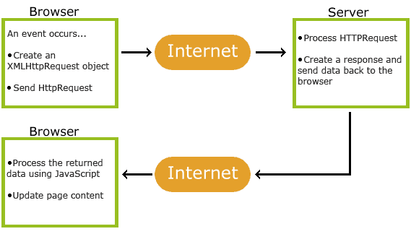
How Ajax Works?

Slide 9
Web Servers
jakarta-tomcat-5.0.28 (with jdk)
Dot Net (.Net) Framework
IBM WebSphere
XAMPP Apatchi Web Server
ZendCore etc.

Slide 10
Common HTML Events
Event | Description
onchange | An HTML element has been changed
onclick | The user clicks an HTML element
onmouseover | The user moves the mouse over an HTML element
onmouseout | The user moves the mouse away from an HTML element
onkeydown | The user pushes a keyboard key
onload | The browser has finished loading the page

Slide 11
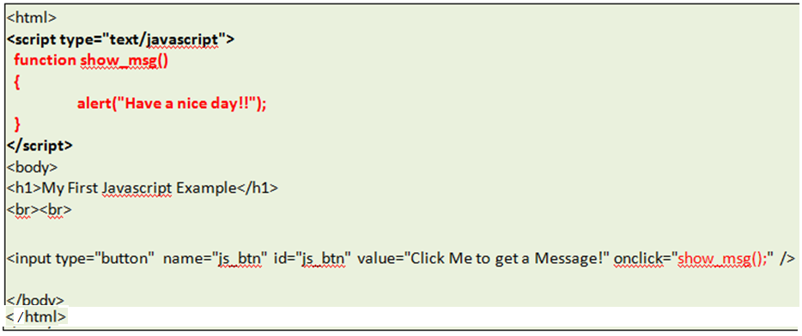
Getting Started with JavaScript
Event: onclick
This program file can be directly executed in browser without Web Server startup
Notes:
Find the factorial of n=5 inside show_msg function

Slide 12
Getting Started with JavaScript
Event: onclick, finding factorial
<html>
<script type="text/javascript">
function show_msg()
{
let fact = 1, number = 5;
for (i = 1; i <= number; i++) {
fact *= i;
}
alert(“Factorial is:” + fact);
}
</script>
<body>
<h1>My first program</h1>
<br><br>
<input type="button" name="js_btn" id="js_btn" value="Click me" onclick="show_msg();"/>
</body>
</html>
This program file can be directly executed in browser without Web Server startup
Notes:
Find the factorial of n=5 inside show_msg function

Slide 13
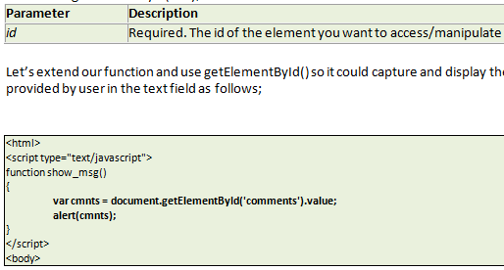
Introducing document ‘getElementById()’ method

Slide 14
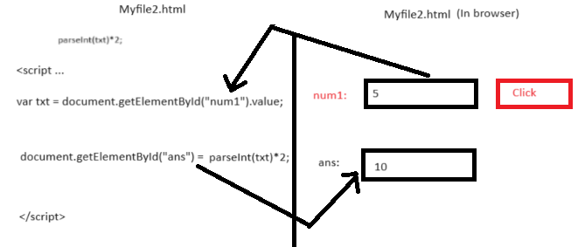
Example: document ‘getElementById()’ method

Slide 15
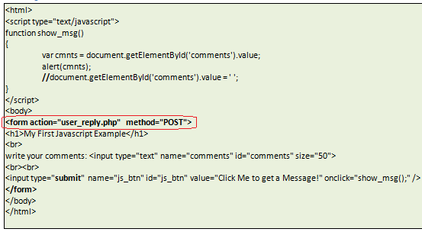
Validation Through JavaScript

Slide 16
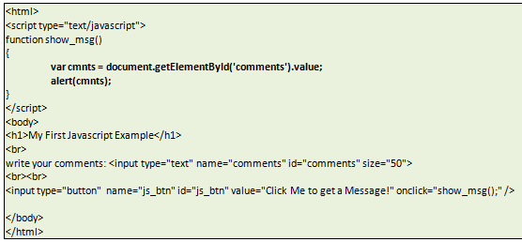
Example

Slide 17
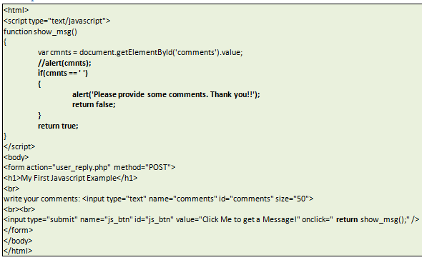
Example …
Notes:
Alternate:
<script>
const appointmentHour = document.getElementById('appointmentHour');
const appointmentMinute = document.getElementById('appointmentMinute');
const appointmentTime = document.getElementById('appointmentTime');
function updateAppointmentTime() {
const hour = appointmentHour.value || 'HH';
const minute = appointmentMinute.value || 'MM';
appointmentTime.value = `${hour}:${minute}`;
visit_time.value = `${hour}:${minute}`;
}
appointmentHour.addEventListener('change', updateAppointmentTime);
appointmentMinute.addEventListener('change', updateAppointmentTime);

Slide 18
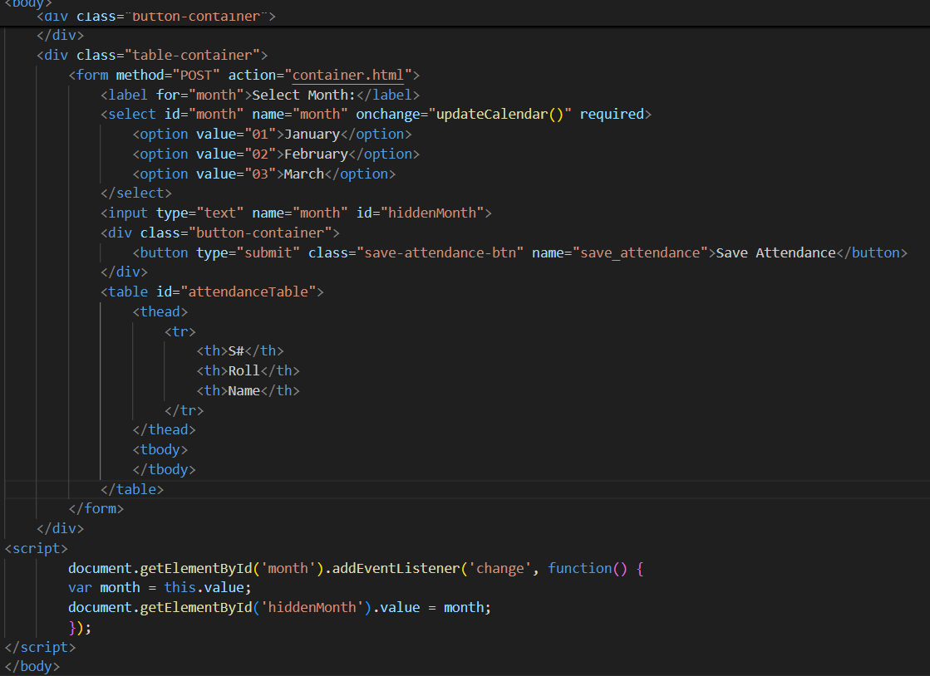
getElementById using Listener

Slide 19
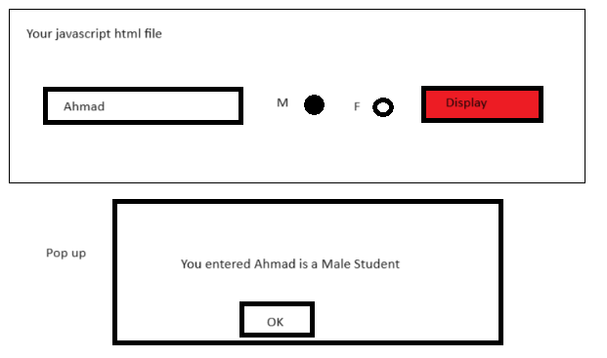
Example …

Slide 20
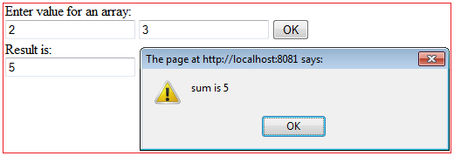
<html>
<head>
<title> Adding two numbers </title>
<script type="text/javascript">
function useSum()
{
var i, total=0, t1_val, t2_val;
var sum=0;
t1_value = document.getElementById("t1").value;
t2_value = document.getElementById("t2").value;
sum = parseInt(t1_value) + parseInt(t2_value);
alert("sum is " + sum);
document.getElementById("display").value=sum;
}
</script>
</head>
<body>
<tr>Enter value for its sum</tr>
<form>
<input type="text" name="t1" id="t1" value="">
<input type="text" name="t1" id="t2" value="">
<tr>Result is </tr>
<div> <input type="text" name="display" id="display" value=""></div>
<input type="button" name="arr_bt" id="ar_bt" value="OK" onclick="useSum();"></br>
</form>
</body>
</html>
Adding Two Numbers

Slide 21
Exercise …
Calculate factorial using getElementByID by putting value in text box

Slide 22
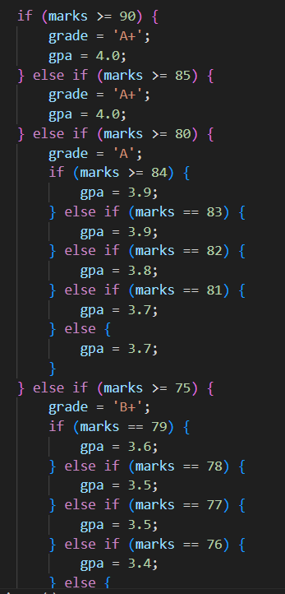
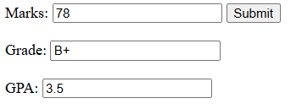
If/ else and nested ifs
Notes:
File: GRADING CRITERIA.docx

Slide 23
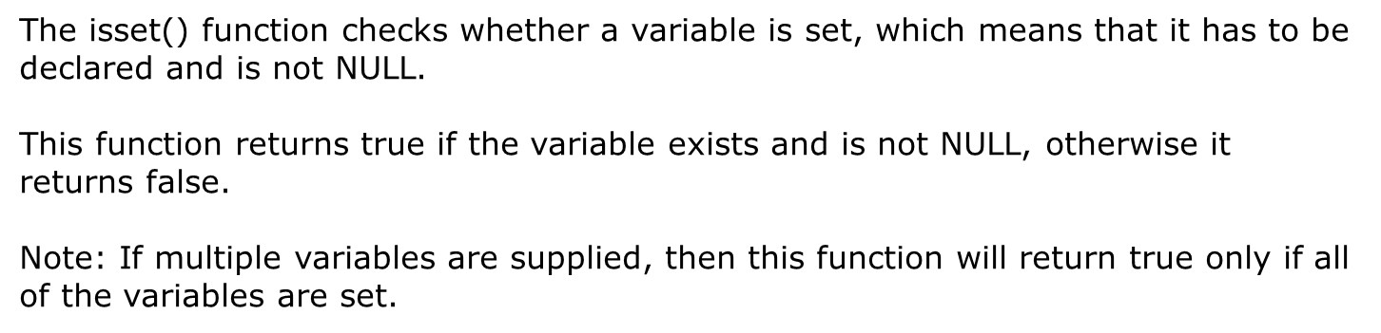
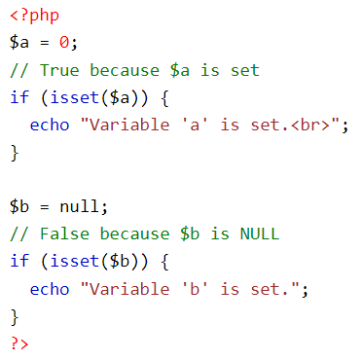
Isset() function is used in php, what about in Javascript

Slide 24
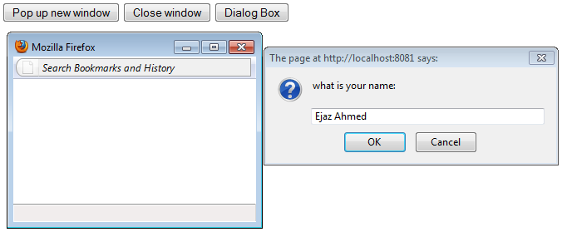
Example – Dialogue Box & Pop up Window

Slide 25
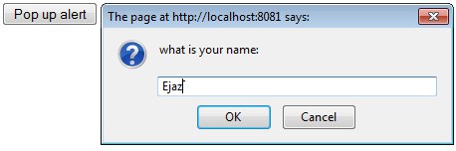
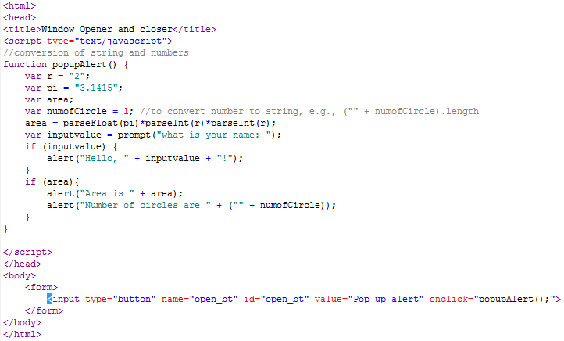
Example – Dialogue Box & Calculations

Slide 26
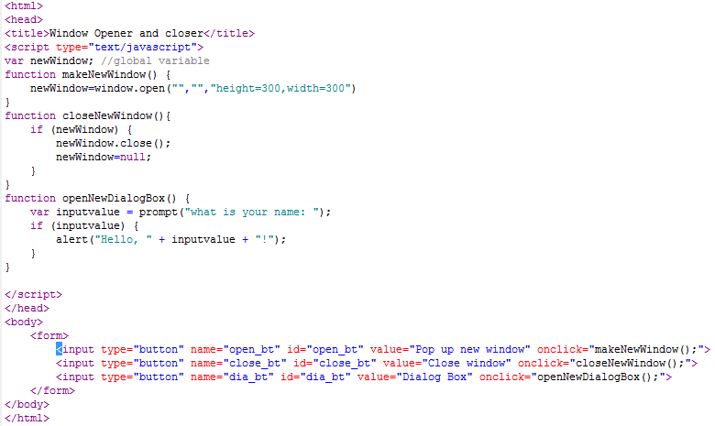
Code - Dialogue Box & Pop up Windows

Slide 27
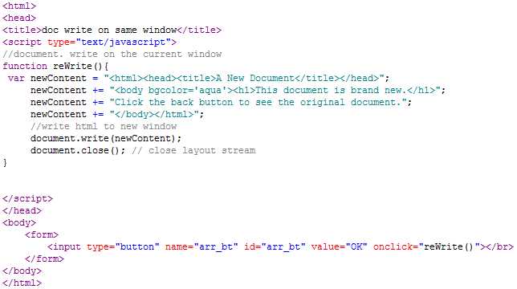

Pop-up window and Document Write

Slide 28
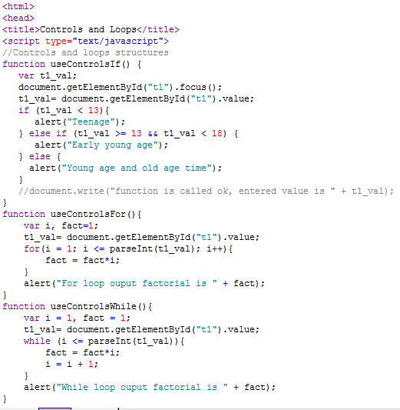
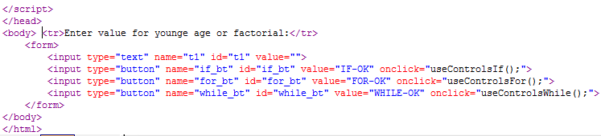

Slide 29

Use of Substring and Instring (searching letter in String)
function copySemCombo()
{
var s_id = document.getElementById('sem_course').value;
document.getElementById('sem_id1').value = s_id;
}
function copyCrsCombo()
{
var c_id = document.getElementById('course_course').value;
document.getElementById('course_id1').value = c_id;
}
Notes:
Sem_course is the id or name of combo box

Slide 30
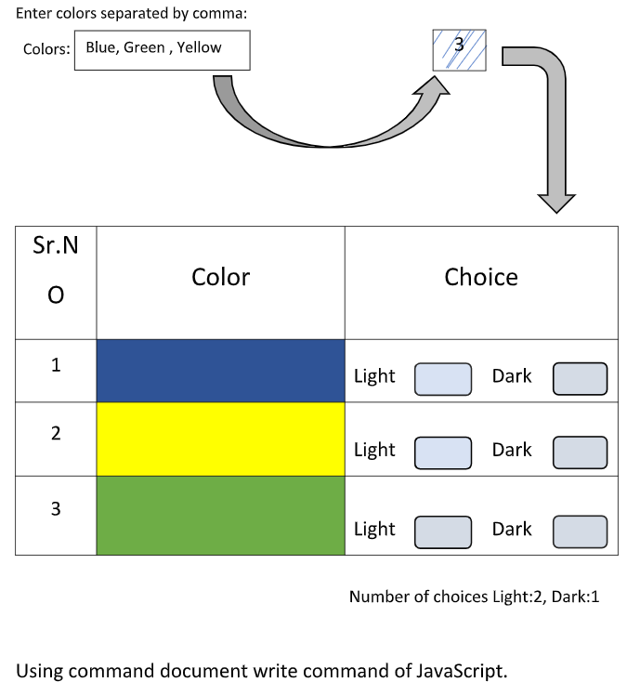
Exercise …
Notes:
In colors enter color names separated by comma, this shows number of colors 3
Below tabular list should populated by presses some button. User will choose choice of Light and Dark color. This shows number of choices

Slide 31
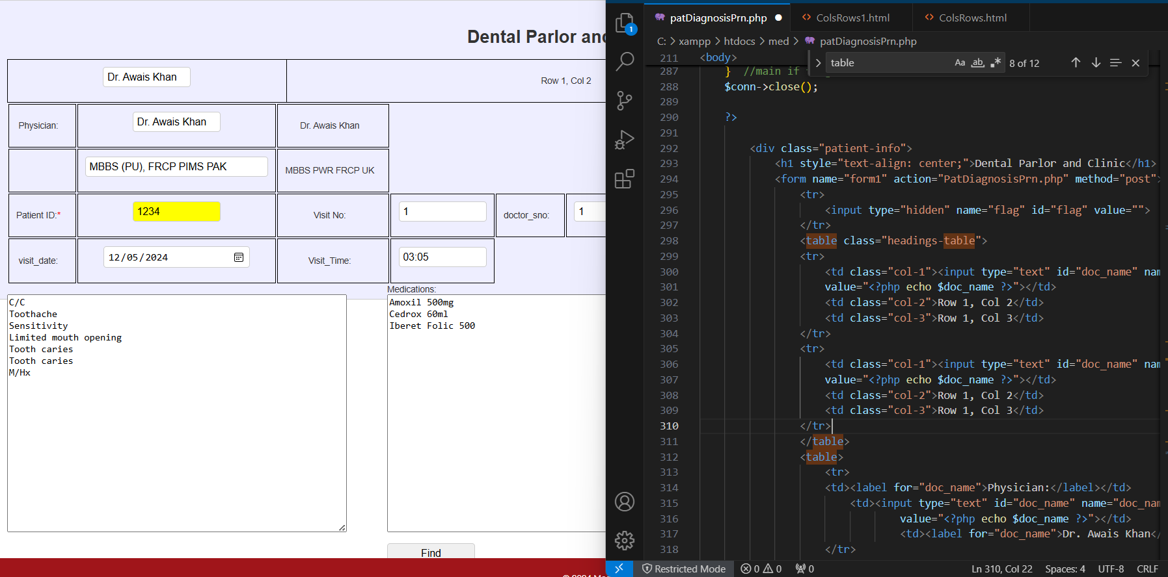
Exercise …
Table styling used for one table only

Slide 32
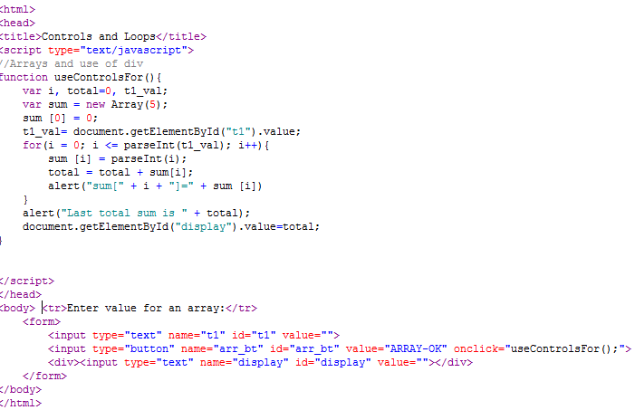

HTML JavaScript Arrays

Slide 33
Display Arrays in html
<html>
<script type="text/javascript">
function showMonths()
{
var i;
var monthNames = ["Jan", "Feb", "Mar", "Apr", "May", "June", "July", "Aug", "Sep", "Oct", "Nov", "Dec"];
for(i=0; i<12; i++){
document.write("<p>" + monthNames[i] + "</p>");
}
alert("Have a nice day");
}
</script>
<body>
<h1>My Array Display Program</h1>
<br><br>
<input type="button" name="js_btn" id="js_btn" value="Click me" onclick="showMonths();"/>
</body>
</html>

Slide 34
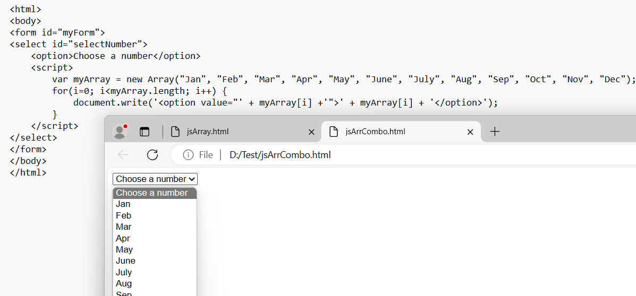
Display Arrays in DropDown List

Slide 35
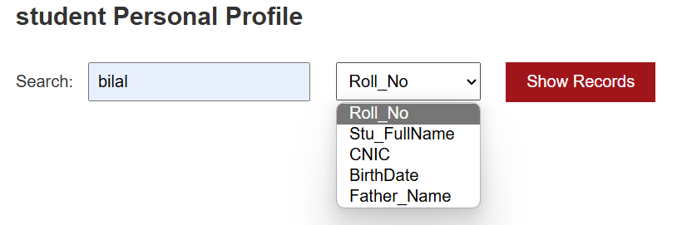
searching input
Notes:
Display message, Stu Full name is displayed, student father name is displayed when choose an option from drop down box

Slide 36
Display Image with texbox input
function displayImage() {
const storeRollNumber = document.getElementById('Roll_No').value;
let storeImage = document.getElementById("image");
let image_path = storeRollNumber + ".jpg";
storeImage.src = image_path;
return false; // Prevent form submission
}
…
<button type="button" onclick="displayImage();">Display </button>
--------------------------------------OR-------------------------------------------------------------------------------------
<script>
function displayImage() {
const filename = document.getElementById('filename').value;
const image = document.getElementById('image');
image.src = filename + '.jpg';
}
</script>
…
<button onclick="displayImage()">Display Image</button>

Slide 37
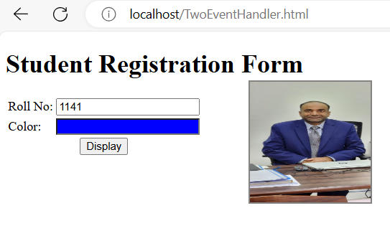
Calling Two Functions in One Button
Code is on next slide
Notes:
Button will call functions to display pictures and change background color of textbox color to blue

Slide 38
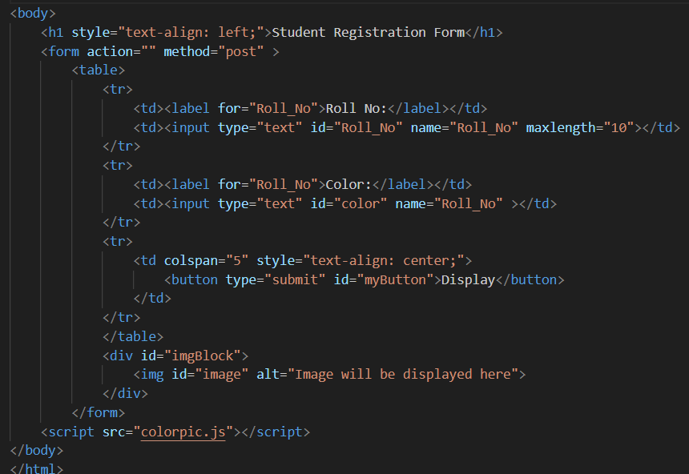
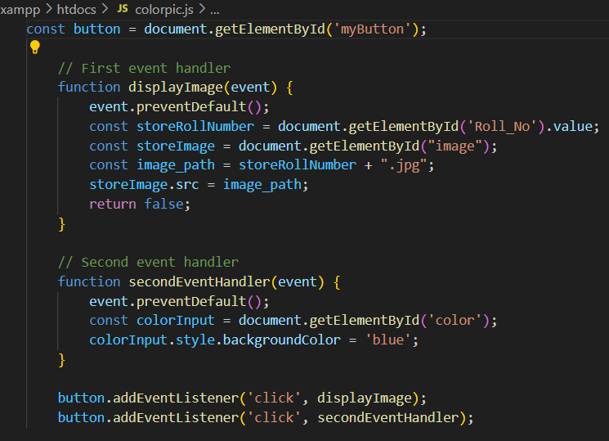

Calling Two Functions in One Button

Slide 39
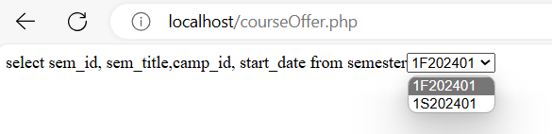
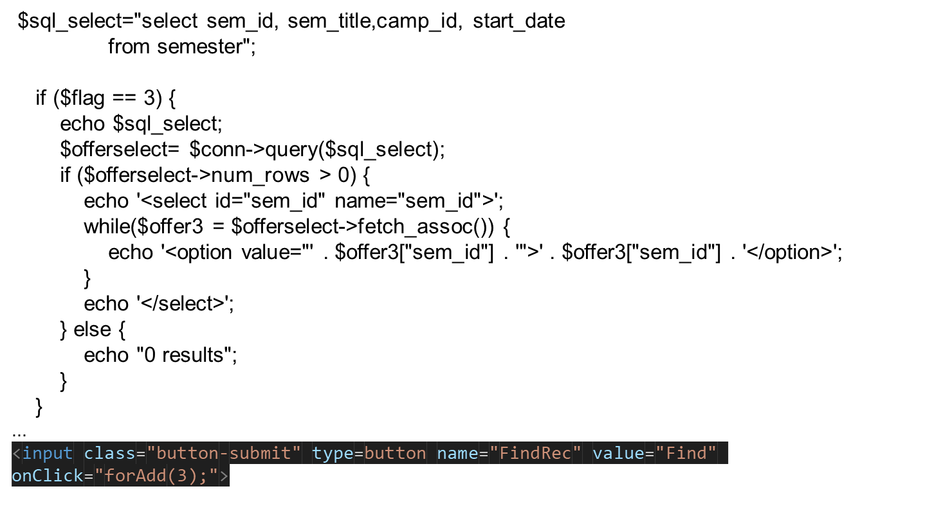
Display of DB data in Combo box

Slide 40
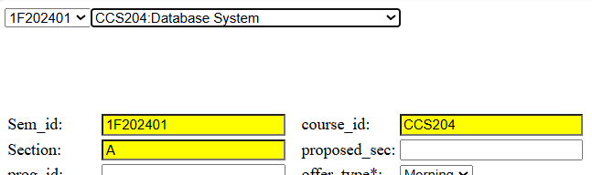
Splitting a String
function getSubstringBeforeColon(inputString) {
// Find the index of the colon
const colonIndex = inputString.indexOf(':');
// Extract the substring before the colon
if (colonIndex !== -1) {
return inputString.substring(0, colonIndex);
} else {
// If no colon is found, return the original string
return inputString;
}
}
// Example usage
const input = "CCS201: Programming Fundamental";
const result = getSubstringBeforeColon(input);
console.log(result); // Output: "CCS201"
Notes:
Just put all code inside script block
Alternate:
function separateString() {
// Split the string by ':'
var input = document.getElementById('sem_course').value;
let parts = input.split(':');
// Extract the part before ':'
let beforeColon = parts[0];
// Further split the part after ':' by '-'
let afterColonParts = parts[1].split('-');
// Extract the part between ':' and '-'
let betweenColonAndDash = afterColonParts[0];
let afterDash = afterColonParts[1];
document.getElementById('sem_id1').value = beforeColon;
document.getElementById('course_id1').value = betweenColonAndDash;
document.getElementById('section').value = afterDash;
return {
beforeColon: beforeColon,
betweenColonAndDash: betweenColonAndDash,
afterDash: afterDash
};
}

Slide 41
Splitting a String (Alternate Method)
function separateString(input) {
// Split the string by ':'
let parts = input.split(':');
// Extract the part before ':'
let beforeColon = parts[0];
// Further split the part after ':' by '-'
let afterColonParts = parts[1].split('-');
// Extract the part between ':' and '-'
let betweenColonAndDash = afterColonParts[0];
alert(beforeColon);
return {
beforeColon: beforeColon,
betweenColonAndDash: betweenColonAndDash
};
}
// Example usage
let inputString = "1F202401:CCS201-A";
let result = separateString(inputString);
console.log(result.beforeColon); // Output: 1F202401
console.log(result.betweenColonAndDash); // Output: CCS201
Notes:
Just put all code inside script block
Alternate:
function separateString() {
// Split the string by ':'
var input = document.getElementById('sem_course').value;
let parts = input.split(':');
// Extract the part before ':'
let beforeColon = parts[0];
// Further split the part after ':' by '-'
let afterColonParts = parts[1].split('-');
// Extract the part between ':' and '-'
let betweenColonAndDash = afterColonParts[0];
let afterDash = afterColonParts[1];
document.getElementById('sem_id1').value = beforeColon;
document.getElementById('course_id1').value = betweenColonAndDash;
document.getElementById('section').value = afterDash;
return {
beforeColon: beforeColon,
betweenColonAndDash: betweenColonAndDash,
afterDash: afterDash
};
}

Slide 42
Calling Function in another Function
function copyCrsCombo() {
var c_id = document.getElementById('course_id').value;
document.getElementById('course_id1').value = getSubstringBeforeColon(c_id);
}
function getSubstringBeforeColon(inputString) {
// Find the index of the colon
const colonIndex = inputString.indexOf(':');
// Extract the substring before the colon
if (colonIndex !== -1) {
return inputString.substring(0, colonIndex);
} else {
// If no colon is found, return the original string
return inputString;
}
}
Notes:
Just put all code inside script block
Alternate:
function separateString() {
// Split the string by ':'
var input = document.getElementById('sem_course').value;
let parts = input.split(':');
// Extract the part before ':'
let beforeColon = parts[0];
// Further split the part after ':' by '-'
let afterColonParts = parts[1].split('-');
// Extract the part between ':' and '-'
let betweenColonAndDash = afterColonParts[0];
let afterDash = afterColonParts[1];
document.getElementById('sem_id1').value = beforeColon;
document.getElementById('course_id1').value = betweenColonAndDash;
document.getElementById('section').value = afterDash;
return {
beforeColon: beforeColon,
betweenColonAndDash: betweenColonAndDash,
afterDash: afterDash
};
}

Slide 43
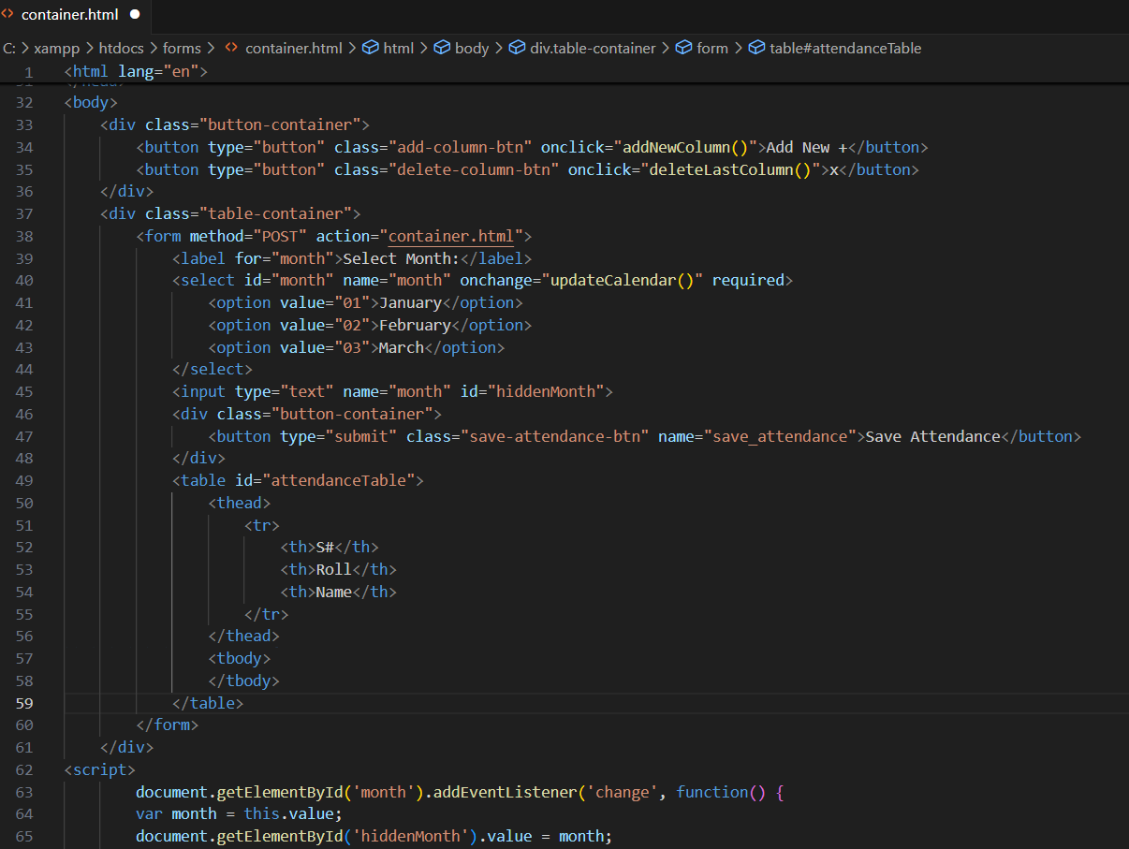
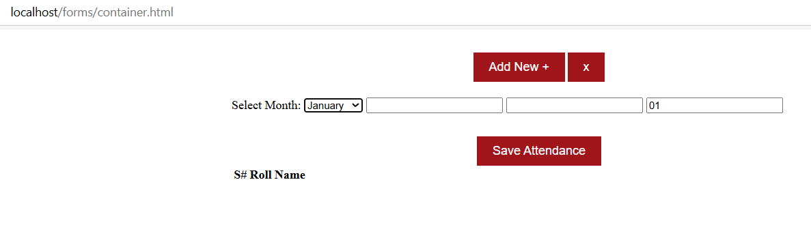
Class Container & Javascript

Slide 44
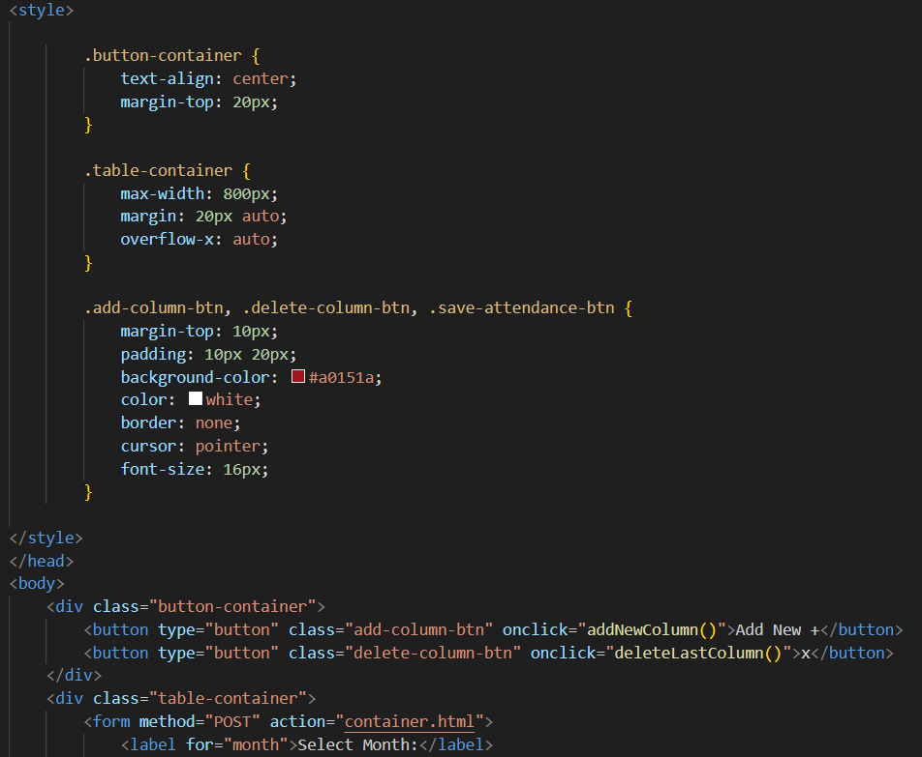
Use of Class Container & Style (.CSS)

Slide 45
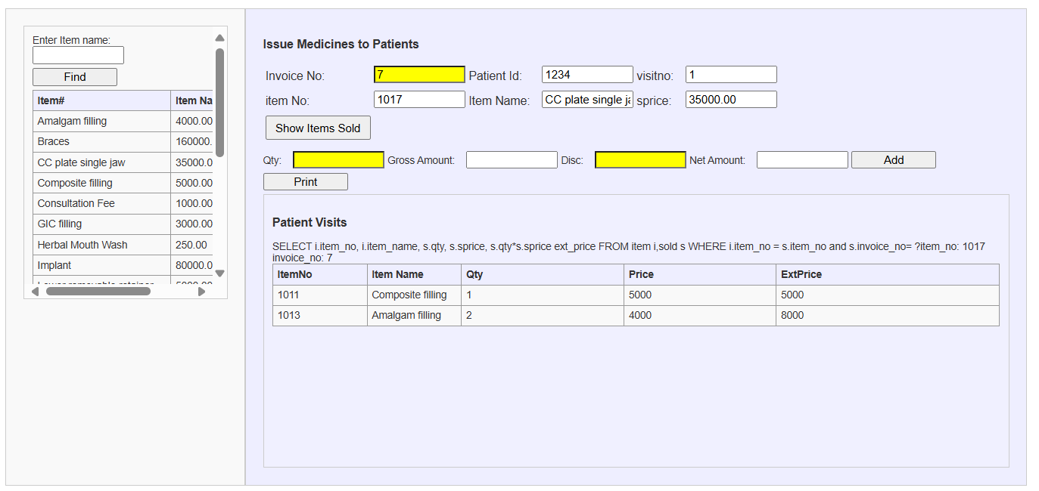
Exercise-2

Slide 46
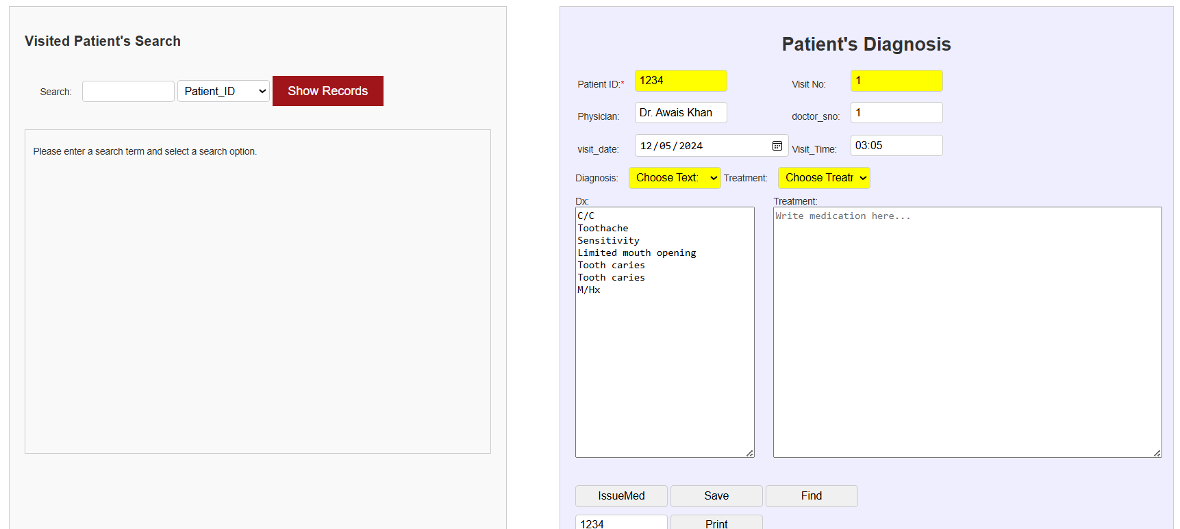
Exercise-3

Slide 47
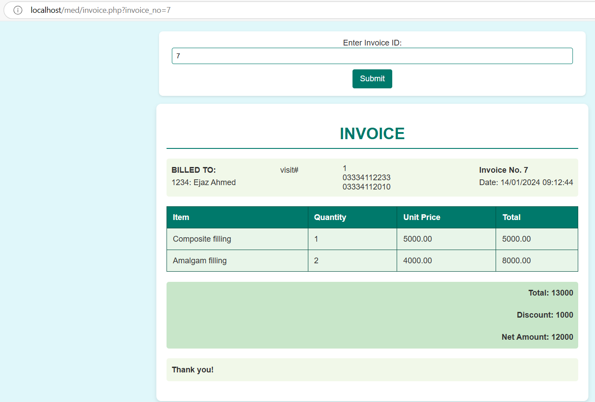
Exercise-1

Slide 48
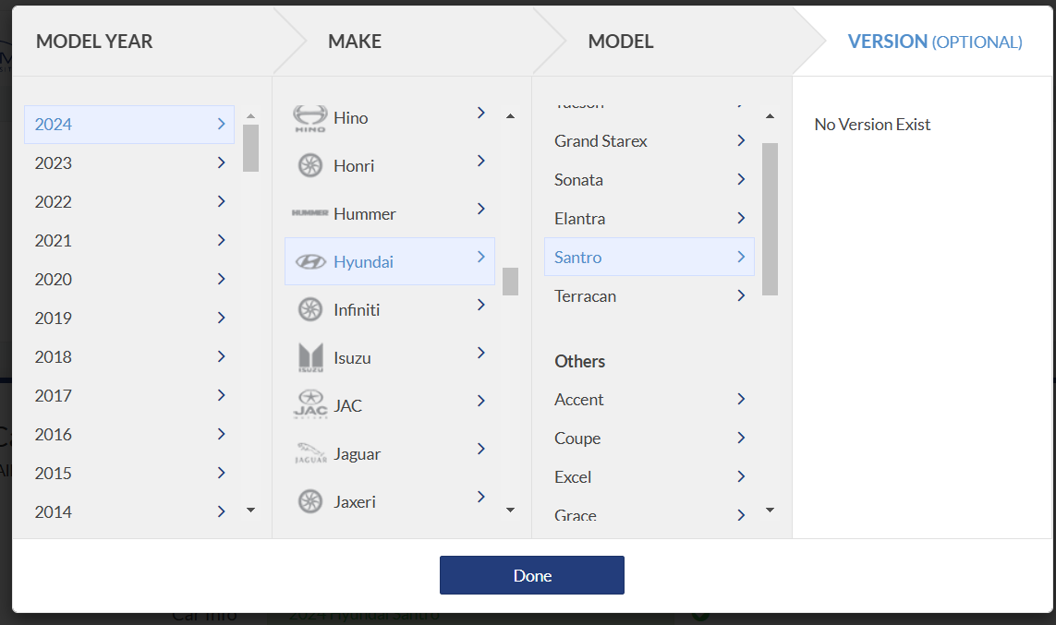
Exercise-2

Slide 49

The End

